Slide 1
Inovirex IT Systems

Slide 2
Welcome!
Inovirex IT Systems
Here is your complete business IT Suite.
For support you can Contact us: support@inovirexitsystems.com
For Info you can contact us:
info@inovirexitsystems.com

Slide 3
1.
About
With a sole focus on providing on-demand and flawlessly managed IT support services across the worldwide landscape, round-the-clock, Inovirex IT Systems is a renowned provider of third-party IT, technical support, Allied health professionals and Medical Billing BPO services. Our staffs is made up of highly qualified and specialized engineers and Medical Health Professionals who are on call around-the-clock to respond quickly to client site visits and skilfully resolve any issues that may arise.
Our engineers and Medical Health Professionals are like valiant troops who are always ready to step up and handle problems on customer locations; they exhibit an unshakeable dedication.

Slide 4
Opportunities don’t happen, You create Them.

Slide 5
Our Services:
IT and Technical Staff:
24/7 Support
Asset Management
IT Stocking
IT Equipment Services
Skilled Allied Health Professionals
BPO Services
Racking/Stacking/ Cabling
Installation & Migration
DC Remote Support
Data Center Relocation

Slide 6
“Success is the sum of small efforts- repeated day in and day out
Bring the attention of your audience over a key concept using icons or illustrations

Slide 7
INOVIREXT IT SYSTEMS.

Slide 8
Inovirex IT Systems is your complete business partner
By providing 24/7 Customer support
BPO Services
By Providing IT and Technical Support
By Providing Allied Health Professionals

Slide 9
Maps
Inovirex IT Systems
Find more maps at slidescarnival.com/extra-free-resources-icons-and-maps

Slide 10
Our Happy Customers:
Microsoft
Meta
Jazz PMCL- Pakistan
Zong Telecommunications Pakistan
NADRA -Pakistan

Slide 11
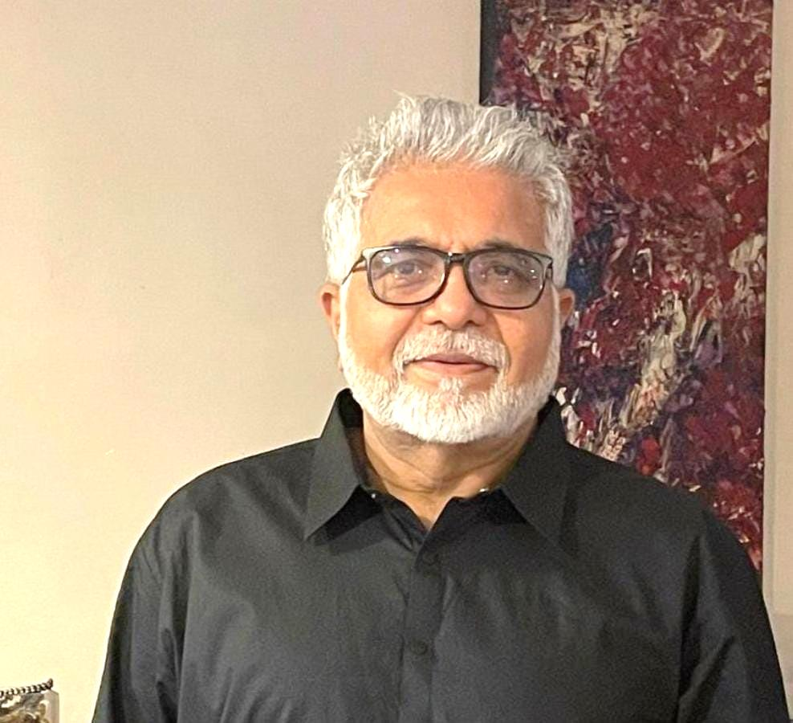
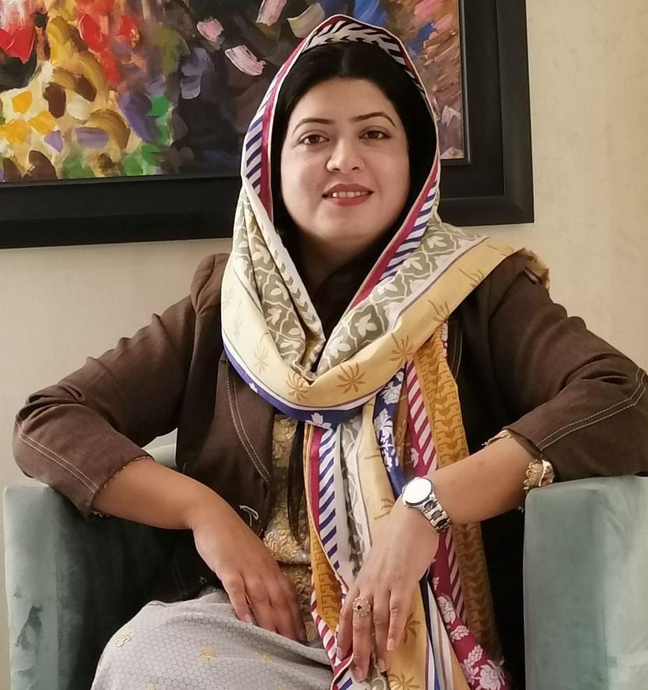
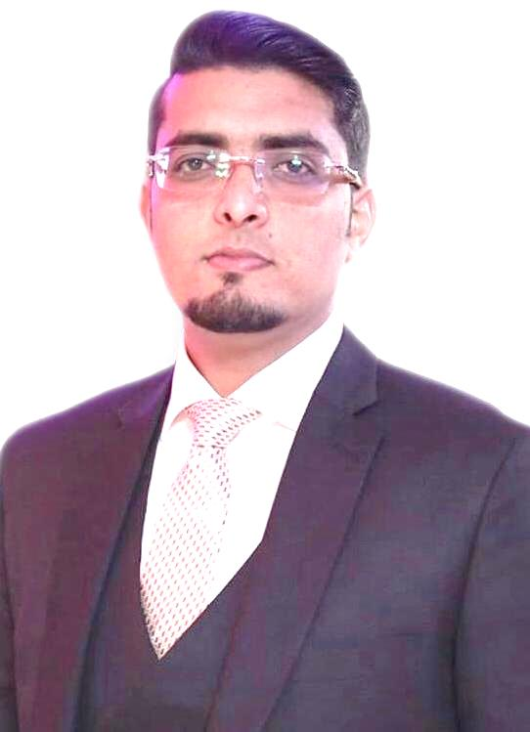
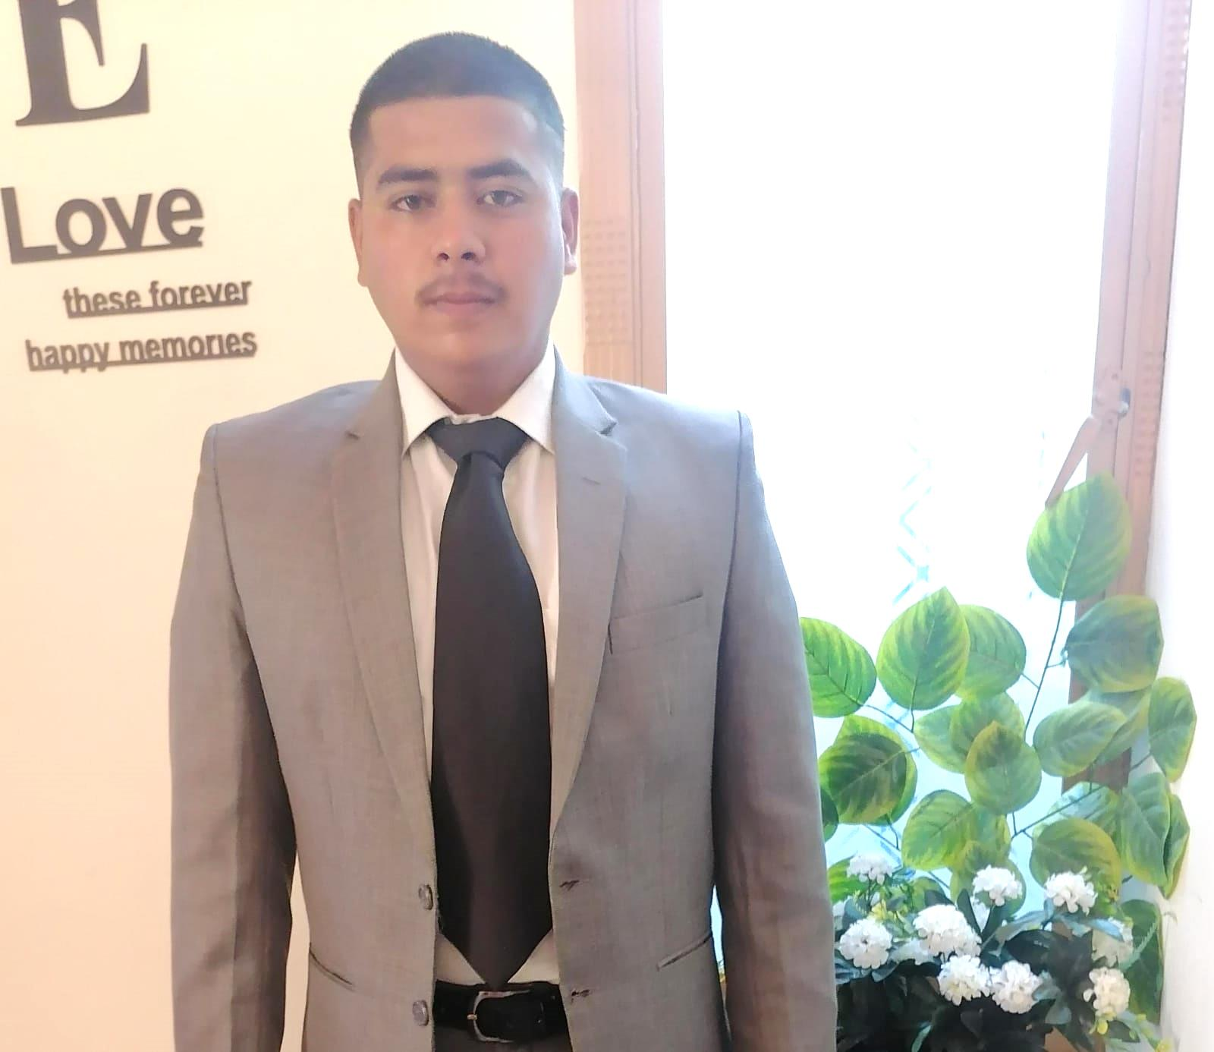
Inovirex IT Systems Team
Noor Parveen Saqib
President
Ali Saqib VP
Amna Bashir
CEO & Founder
Eisha Fatima
COO
Bilal Ahmed CO- Founder
Muhammad Zakria
Director

Slide 12
Thanks!
For any questions and queries please reach us at:
HQ: 1846 E. Innovation Park Dr., STE 100 Oro Valley , AZ 85755
Contact: +17144763386
Regional Office: Plot 09, St :1A, Jinnah Abad Rd, 45400 ,Islamabad, Pakistan.
Contact: +923018118371 /+923028118371
Email: support@inovirexitsystems.com

